Slide 1
On Mining Mobile Apps Usage Behavior for Predicting Apps Usage in Smartphones
Date : 2014/04/01
Author : Zhung-Xun Liao, Yi-Chin Pan, Wen-Chih Peng, Po-Ruey Lei
Source : CIKM’13
Advisor : Jia-ling Koh
Speaker : Shao-Chun Peng

Slide 2
Outline
Introduction
Method
Experiments
Conclusion

Slide 3
Introduction
Motivation
Proliferation of Mobile applications
Predicting Apps usage facilitates fast Apps launching, intelligent user experience, and power management in smartphones.

Slide 4
Existing approaches
Collect a bunch of different types of sensor
Energy and storage consumption
Noise data

Slide 5
Purpose
Propose a Temporal-based Apps Predictor, called TAP, which dynamically lists k Apps which are most likely to be used.

Slide 6
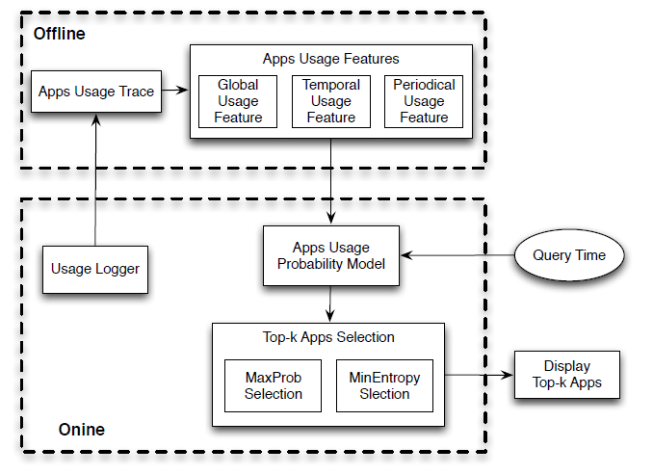
Framework

Slide 7
Outline
Introduction
Method
Experiments
Conclusion

Slide 8
Mobile Applications Features
Global usage feature
Records the global usage count of each App
Temporal usage feature
Records the usage counts regarding to a specific temporal bucket
Periodical usage feature
Reveals the usage periods of each App

Slide 9
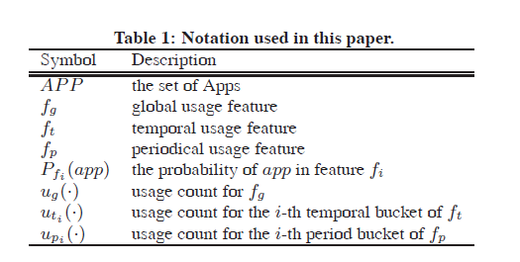
Notation

Slide 10
Global usage feature
the usage behavior of the Apps who are used frequently in the global
fg(app) =< ug(app) >
APP | Global usage
Gmail | 40
Facebook | 10
Alarm | 15
Candler | 15
Line | 5
Angry bird | 15
Pfg(Gmail)=$\frac{40}{40+10+15+15+5+10}=$0.4

Slide 11
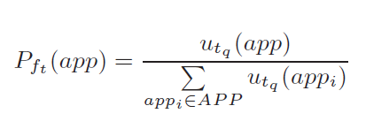
Temporal usage feature
A user would more likely use the Apps which are used in the same temporal bucket as qt.
f(app) =< ut1 (app), ut2 (app), . . . ,ut24 (app) >
Gmail:10
Bucket 08:00~09:00
4/1
Alarm:12
Gmail:20
Ut9(Gmail)=$\frac{10+20}{2}=15$
Alarm:8
Pft(Gmail)=$\frac{15}{15+10}=0.6$
Bucket 08:00~09:00
4/2

Slide 12
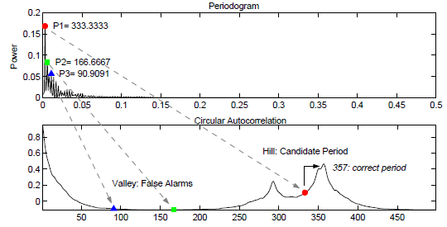
Periodical usage(period)
References: On periodicity detection and structural periodic similarity
for the query ‘Easter’ for 1000 days after the beginning of 2002

Slide 13
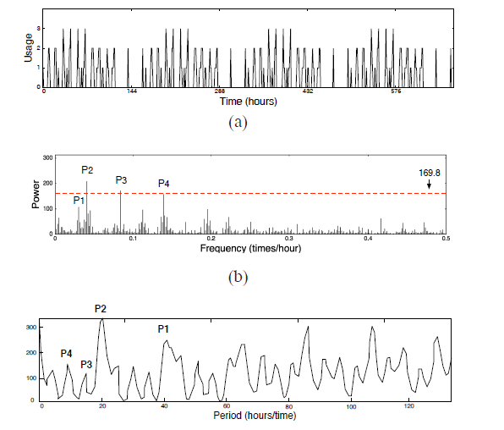
Periodical usage feature
The usage periods of each App
use APP
1 hour ago
T(APP)=3(hour)
Now
10:00
Put into
Bucket 12:00~

Slide 14
probability model
use the probability model of app when the query time falls into the q-th bucket of its period

Slide 15
Top-K Selection
MaxProb selection
MinEntropy selection

Slide 16
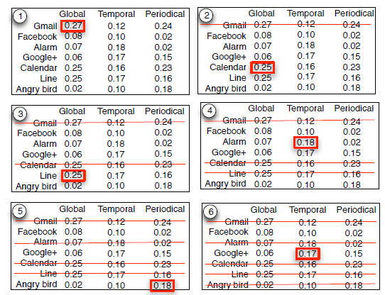
MaxProb selection
uses the maximum probability over three features as the usage probability of the App
cross-feature comparison
dominated by single feature

Slide 17
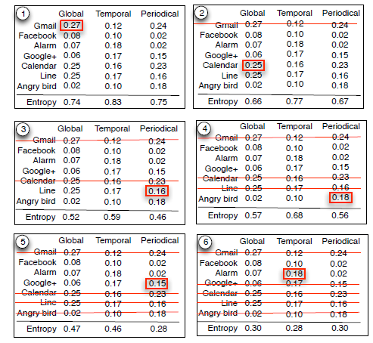
MinEntropy selection
select the maximum probability from the features which has the minimum entropy
entropy=−(0.27 × log 0.27 +0.08 × log 0.08 + 0.07 × log 0.07 + 0.06 × log 0.06 +0.25 ×log 0.25 + 0.25 × log 0.25 +0.02 × log 0.02) = 0.74

Slide 18
Outline
Introduction
Method
Experiments
Conclusion

Slide 19
Data set
Small:15 participants’ usage traces from July to December in 2010
Large:80 participants from October 2009 to February 2011.
Each dataset is separated as 60% for training and 40% for testing

Slide 20
baseline
input of existing works are very different from ours in this paper

Slide 21
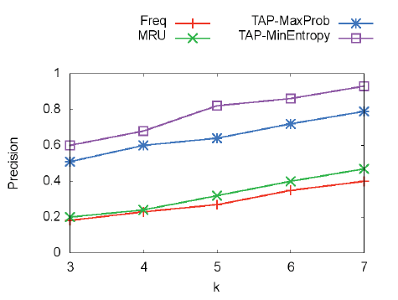
Experiments

Slide 22
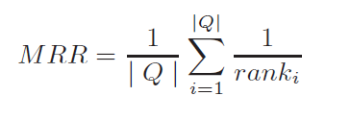
Experiments
Results | Correct response | MRR
Gmail, Alarm, calendar | calendar | 1/3
Gmail, Alarm, calendar | Alarm | 1/2
Gmail, Alarm, calendar | Gmail | 1/1
MRR=(1/3+1/2+1/1)/3

Slide 23
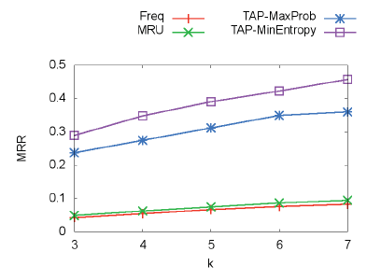
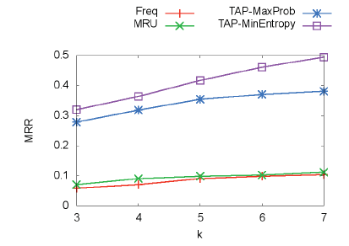
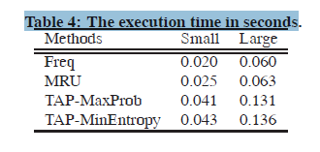
Experiments

Slide 24
Outline
Introduction
Method
Experiments
Conclusion

Slide 25
Conclusion
propose a Temporal-based Apps predictor to predict k Apps which are most likely to be used at a given query time
Propose two selection algorithms, MaxProb and MinEntropy

